Slide 1
KALMAN FILTER
A Brief Introduction and q/kdb+ Implementation
Mark Lefevre

Slide 2
The KALMAN FILTER
A statistical algorithm that produces accurate estimates of unknown state variables in the presence of noise and other inaccuracies
Recursive and can be used in real-time
Uses a 2 Step Process
Predict – estimate current state variables
Update – use next measurement to update estimate using a weighted average
Noise Smoothing
State Estimation
Quick Convergence
Notes:
Bayesian Connection
-Have a belief about the state of the world
-Ingest new measurements/data
-If the new data contradicts my belief,
I am less certain about my belief and I slightly update my belief
-If it supports my belief
I am more certain and I don’t update
-Useful when you already have a model

Slide 3
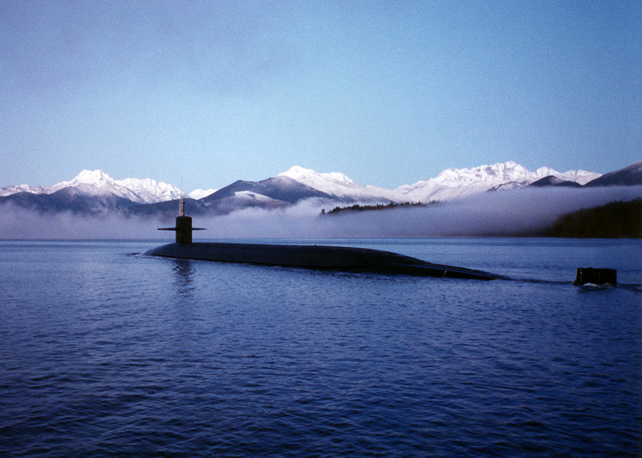
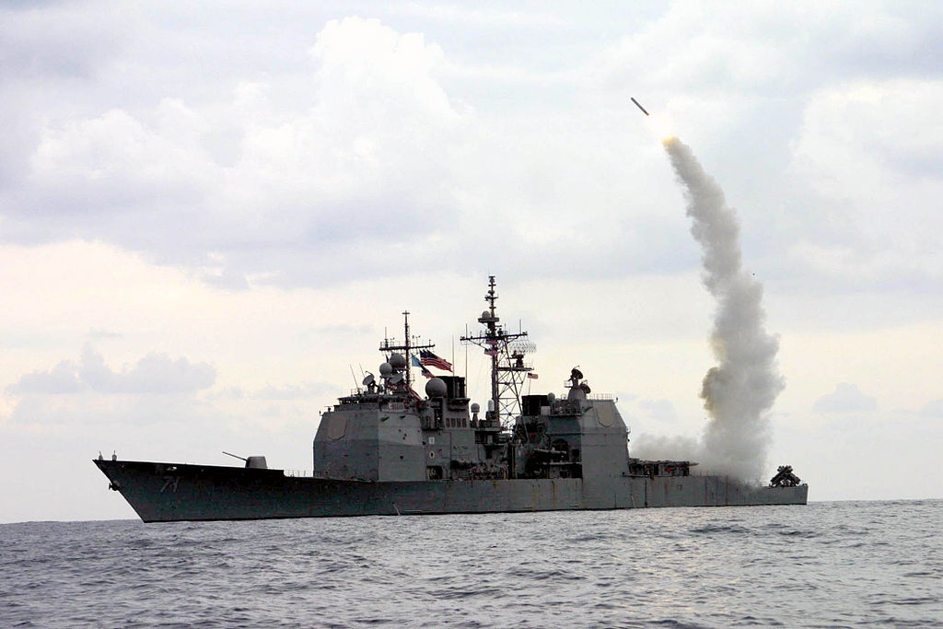
APPLICATIONS of KALMAN FILTERs
Target tracking
Satellites, Missiles, Aircraft, Spacecraft, UAVs
Guidance/Navigation (GPS, IM)
Sensor fusion (ex. RADAR, LIDAR, LASER)
Computer Vision
Economics
Finance
Notes:
Aeronautics
navigation of US Navy ballistic missile submarines
guidance and navigation of US Navy Tomahawk missile
US AF Air Launched Cruise Missile
Robotics, autonomous vehicles
Economics
Estimate parameters for ARMA models
Modeling regime changes
Forecasting economic indicators
Finance
Simple example: replace moving averages
Estimate beta (which is an extremely noisy quantity using returns)
Can compute rolling estimates
Avoids having to choose a finite lookup window
Dr. Aidan O’Mahoney has a cool blog
http://www.thealgoengineer.com/2014/online_linear_regression_kalman_filter/
Subject of lots of academic research and widely applied in many different industries

Slide 4
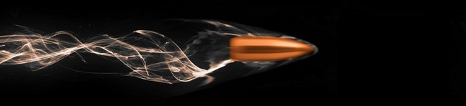
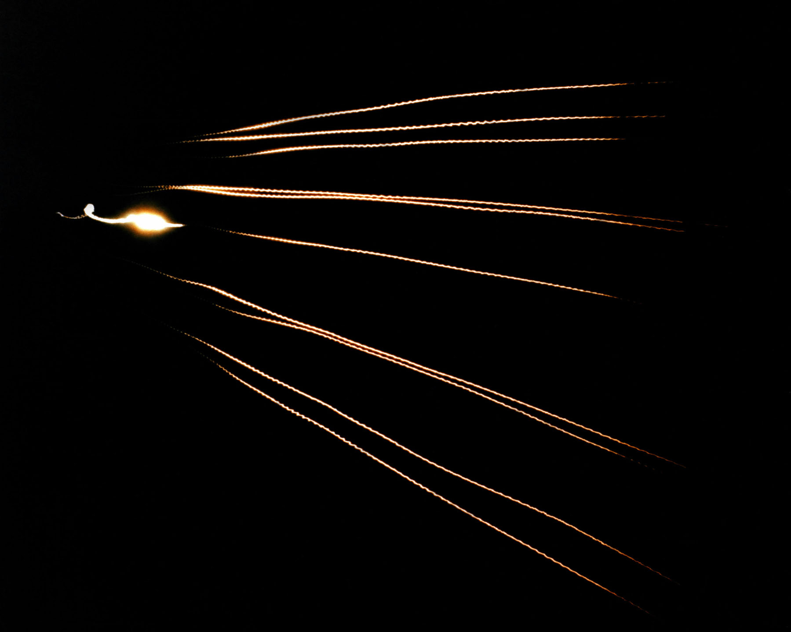
Realistic Ballistic Trajectory
Aerodynamic Drag
Altitude Effects
Changes in Air Density
Decrease in Gravity
Winds/Weather
Coriolis Effect
Earth Curvature
Target Motion
Internal Propulsion
Multiple Stages/MIRV
Notes:
Aerodynamic drag is also known as air resistance
Winds/Weather
Gusty near the ground
Fast high-altitude jet stream
Humidity, Precipitation
Coriolis Effect is the deflection of the trajectory due to the spinning of the Earth. Even in long-range sniping this becomes important at around 1000 meters. Targets can rise or drop about 6 inches depending if you are shooting east (rise) or west (fall). North/South results in 3 inches move left (Southern Hemisphere) or right (Northern Hemisphere).
Earth Curvature Earth is actually an oblate spheroid. The radius at the equator is greater than at the poles.
ICBMs typically have multiple stages. The LGM-118A Peacekeeper has 4 propulsion stages. 3, solid-fuel and 1, post-boost liquid-fuel for velocity and attitude correction.
Ballistic Trajectory is also called Projectile Motion
Timed exposure shows 10 MK-21 re-entry vehicles (RV) approaching an open-ocean impact zone near Kwajalein Atoll during a flight test
These would ride inside an American LGM-118A Peacekeeper ICBM
Typical ICBMs have a range of 10k km and a speed of around 7km/s
Image Source:
https://en.wikipedia.org/wiki/File:MIRV-Reentry.jpg

Slide 5


Simple Projectile Motion
Instantaneous Launch
No Aerodynamic Drag, Winds
Only Acceleration due to Gravity
$g=−9.8\frac{m}{s^{2}}$
Equations
Acceleration
$$a_{x}=0 \\ a_{y}=g$$
Velocity
$$v_{x}=v_{0}\cos{θ}$$
$$v_{y}=v_{0}\sin{θ}+gt$$
Displacement
$$x={x_{0}+v}_{0}t\cos{θ}$$
$$y={y_{0}+v}_{0}t\sin{θ}+\frac{1}{2}gt^{2}$$
Notes:
Ballistic Trajectory is also called Projectile Motion
This is a high school physic refresher in projectile motion
Projectile motion can be simply decomposed into independent motions in the x and y direction
Note that g here is defined as a negative so the terms due to acceleration are added
Galileo determined that the curved path is parabolic
This plot is two curves superimposed on each other. The continuous line is calculated using these equations. The dots are calculated using a state space model which I will introduce in a few slides.

Slide 6

Measurement Problem
Actual state of the system is not directly observable
Any measurement of the system outputs are unavoidably noisy
Process Model
$$x_{k}=Ax_{k−1}+Bu_{k}+w_{k−1}$$
Measurement Model
$$z_{k}=Hx_{k}+v_{k}$$
Process and Measurement Noise
$$p\left(w\right)\sim N\left(0,Q\right) \\ p\left(v\right)\sim N(0,R)$$
Notes:
https://www.cs.unc.edu/~tracker/media/pdf/SIGGRAPH2001_CoursePack_08.pdf
We want to estimate internal states only by observing the outputs of the system
We use a state-space model
The process model is a linear stochastic difference equation which models the transition of the internal state
The measurement model is a linear stochastic equation which represents the measure of the current state
The measurement does not have to be all the state element and can be any linear combinations of them
Measurement errors can be due to sensor limitations, electrical noise, atmospheric conditions, etc.
Actual state transitions are completely unknown
Process models intentionally incorporate notions of random motion for the reasons mentions in realistic ballistic trajectories
w_k-1 and v_k are random variables
Assume that noises are independent zero mean Gaussians

Slide 7

State-Space Model
Convert the equations
Discretization
Use matrix notation
$$x_{k}=Ax_{k−1}+Bu_{k}$$
A, State Transition Model
B, Control-Input Model
$x_{k}$, current state
$x_{k−1}$, previous state
$u_{k}$, static vector
/ create_stm: Create a state transition model for a projectile in 2D
/ [d]elta [t]ime is the change in time for each time step
create_stm:{[dt] 4 4#@[16#0.;*[5;til 4],2 7;:;#[4;1.],#[2;dt]]};
/ create_cim: Create a control-input model for a projectile in 2D
/ CIM accounts for the effect of acceleration on position and velocity
create_cim:{[dt] 4 2#@[8#0.;0 3 4 7;:;raze 2#'(0.5*dt*dt;dt)]};
/ create_initial_state: Create an initial state
/ [t]heta, angle at which projectile is fired in degrees
/ [v]elocity, initial velocity at which projectile is fired
create_initial_state:{[t;v]
pi:acos -1;
r:%[t;180]*pi;
4 1#@[4#0.;2 3;:;(v*cos r;v*sin r)]
};

Slide 8




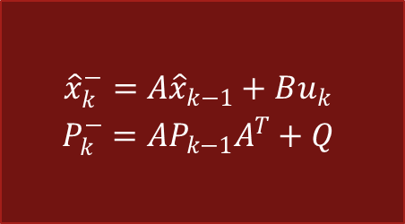
A Kalman Filter
Initial State
Predict
Choice an Initial State
Predict
Project the state
Project the error covariance
Correct
Compute the Kalman Gain
Update estimate with measurement
Update the error covariance
$$\begin{matrix}x_{0} \\ P_{0}\end{matrix}$$
$$\begin{matrix}{\hat{x}}_{k}^{−}=A{\hat{x}}_{k−1}+Bu_{k} \\ P_{k}^{−}=AP_{k−1}A^{T}+Q\end{matrix}$$
Correct
$$\begin{matrix}K_{k}=\frac{P_{k}^{−}H^{T}}{HP_{k}^{−}H^{T}+R} \\ \left.{\hat{x}}_{k}={\hat{x}}_{k}^{−}+K_{k}(z_{k}−H{\hat{x}}_{k}^{−}\right) \\ P_{k}=\left(1−K_{k}H\right)P_{k}^{−}\end{matrix}$$
$${\hat{x}}_{k}$$
$$z_{k}$$
Notes:
Kalman filters are based on linear dynamical systems discretized in the time domain

Slide 9

DISCRETE Kalman Filter
Predictor-Corrector Estimator
Maintains 2 statistical moment (state, error covariance)
Minimizes Error Covariance
Define a priori and a posteriori Estimate Errors
$$e_{k}^{−}≡x_{k}−{\hat{x}}_{k}^{−}$$
$$e_{k}≡x_{k}−{\hat{x}}_{k}$$
Estimate a priori and a posteriori Covariances
$$P_{k}^{−}=E\left[e_{k}^{−}{e_{k}^{−}}^{T}\right]$$
$$P_{k}=E\left[e_{k}{e_{k}^{−}}^{T}\right]$$
Compute a posteriori State Estimate
$${\hat{x}}_{k}={\hat{x}}_{k}^{−}+K(z_{k}−H{\hat{x}}_{k}^{−})$$
Notes:
Compute a prosteriori state estimate as a linear combination of a prior estimate and weighted difference between an actual measurement and a measurement prediction
Difference term in red is called the measurement innovation or the residual.
The residual is the discrepancy between the predicted measurement and the actual measurement

Slide 10

Kalman Gain
Kalman Gain is Chosen to Minimize a posteriori Error Covariance
$K_{k}=\frac{P_{k}^{−}H^{T}}{HP_{k}^{−}H^{T}+R}$
Blending Factor which Weights the a priori Estimated State and the Measurement
Value is between 0 and 1
As Measurement Error Covariance R tends to 0
Residual has more weight
As a priori Estimated Error Covariance $P_{k}^{−}$ tends to 0
a priori Estimated State has more weight

Slide 11
q/KDB+ Code
/ Projectile Motion Parameters
theta:45;
v0:300;
g:-9.8;
tof:(2*v0*sin acos[-1]*theta%180)%neg g;
nsteps:1000;
dt:tof%nsteps;
stm:create_stm[dt];
cim:create_cim[dt];
is:create_initial_state[45;v0];
results:{flip `x`y`vx`vy!flip x} raze each
nsteps {[stm;cim;x] (stm$x)+cim$2 1#0 -9.8}[stm;cim;]\ is;
results:`t xcols update t:0+dt*til 1+nsteps from results;
/ Kalman Filter Matrices/Helper Functions
create_Q:{[dt;v] G:4 1#raze 2#'(0.5*dt*dt;dt); Q:*[v;v]*G$flip G};
create_P:{4 4#16#x,4#0.};
create_H:{2 4#rotate[-2;8#x,4#0.]};
create_R:{2 2#4#x,2#0.};
create_I:{4 4#16#1.,4#0.};
Q:create_Q[dt;1.];
P0:create_P[10.];
H:create_H[1.];
ra:5.0;
R:create_R[ra*ra];
I:create_I[];
u:2 1#0.,g;

Slide 12
q/KDB+ Code
/ Predict
predState:{[A;x;B;u] (A$x)+B$u};
predErrCov:{[A;P;Q] Q+(A$P)$flip A};
predict:{[A;x;B;u;P;Q] (predState[A;x;B;u];predErrCov[A;P;Q])};
/ Create a projection (only x (state variables) and P (error covariance matrix) change each iteration)
predict_p:predict[stm;;cim;u;;Q];
kf:{[x;P;Z]
aposteriori:correct_p[;;Z] . reverse apriori:predict_p . (x;P);
apriori,aposteriori
};
/ Correct
computeKalmanGain:{[P;H;R] (P$flip H)$inv R+(H$P)$flip H};
updateEstimate:{[prevxhat;K;z;H] prevxhat+K$z-H$prevxhat};
updateErrCov:{[I;K;H;P] (I-K$H)$P};
correct:{[prevP;H;R;prevxhat;Z;I]
K:computeKalmanGain[prevP;H;R];
xhat:updateEstimate[prevxhat;K;Z;H];
P:updateErrCov[I;K;H;prevP];
(K;xhat;P)
};
/ Create a projection (only prevP (a priori error covariance estimate),
/ prevxhat (a priori state estimate), Z (new measurement) change each iteration)
correct_p:correct[;H;R;;;I];

Slide 13
q/KDB+ Code
/ Create noisy measurements
/ Use Psaris' bm implementation for normal variates
\l stat.q
update vxn:vx+sqrt[R[0;0]]*.stat.bm nsteps?1f,vyn:vy+sqrt[R[1;1]]*.stat.bm nsteps?1f from `results where i>0;
history:();
x:is;
x:create_initial_state[55;1.75*v0];
P:P0;
measurements:select vxn,vyn from results where i>0;
while[0<count measurements;
Z:2 1#value measurements[0];
history:history,enlist res:kf[x;P;Z];
measurements:1_measurements;
x:res 3; P:res 4;
];
t | x | y | vx | vy | vxn | vyn
0 | 0 | 0 | 212.132 | 212.132 | 0n | 0n
0.04329225 | 9.183673 | 9.17449 | 212.132 | 211.7078 | 211.5433 | 210.1631
0.0865845 | 18.36735 | 18.33061 | 212.132 | 211.2835 | 209.3 | 202.8508
0.1298768 | 27.55102 | 27.46837 | 212.132 | 210.8592 | 212.5902 | 201.0393
0.173169 | 36.73469 | 36.58776 | 212.132 | 210.435 | 200.4968 | 217.8728
0.2164613 | 45.91837 | 45.68878 | 212.132 | 210.0107 | 215.6915 | 202.8268
0.2597535 | 55.10204 | 54.77143 | 212.132 | 209.5864 | 206.9672 | 212.3463
0.3030458 | 64.28571 | 63.83571 | 212.132 | 209.1622 | 224.7602 | 219.5127
0.346338 | 73.46939 | 72.88163 | 212.132 | 208.7379 | 223.8947 | 203.4936

Slide 14
Kalman Filter Example
Notes:
These results were created with the q/kdb+ code I have shown.
There is an element of randomness, so unless your seed value was the same, the results will be slightly different.

Slide 15
Kalman Filter Example

Slide 16
Kalman Filter Example

Slide 17
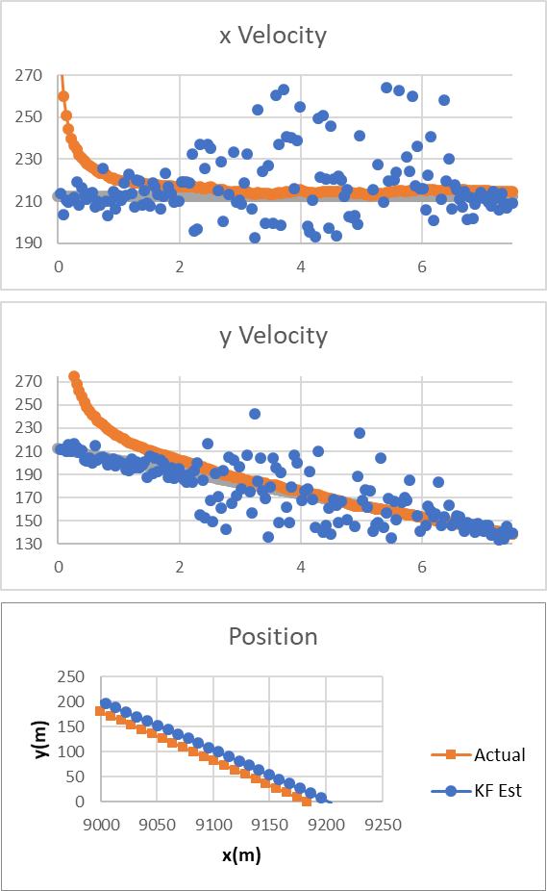
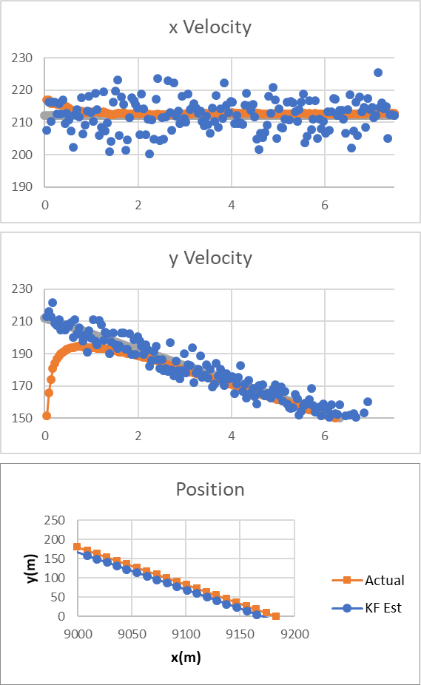
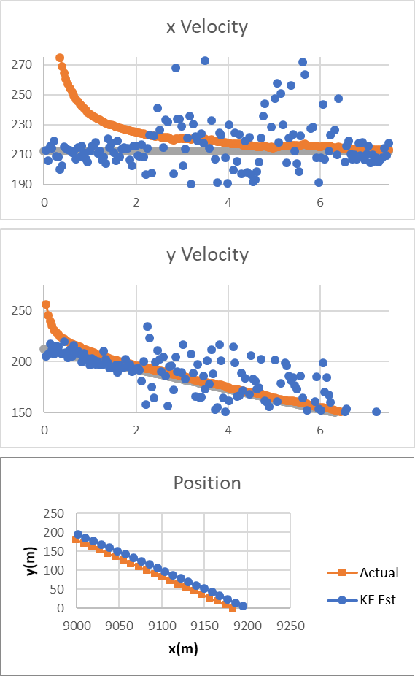
Kalman Filter Robustness
Notes:
The Kalman Filter is quite robust to errors in the initial estimate as well as changes in the noise variance
Example 2 uses the same initial estimate with a burst of 5X noise
Example 3 uses a slower, flatter estimate with 30 degree and 255m/s
Example 4 uses a faster, flatter estimate with 30 degress and 555m/s combine with a 5X noise

Slide 18
EXTENSIONS
Extended Kalman Filter (EKF)
Standard KF applied to first order Taylor’s approximation on non-linear state-space model
Unscented Kalman Filter (UKF)
Uses Sigma Points to take additional weighted points on source Gaussian and map them to target Gaussian through a non-linear function
Central Kalman Filter (CKF)
Very computational expensive
Distributed Kalman Filter (DKF)
Uses distributed microfilters and a consensus filter
Ensemble Kalman Filter (EnKF)
Notes:
Kalman Filter assumes linearity
Measurement is a linear function of state
Next state is a linear function of previous state

Slide 19
Summary
Given a linear dynamical system, a Kalman Filter finds an optimal estimate of the state vector
Optimal in a least squares sense
Memory efficient
Extremely Fast
In addition to state, provides estimation quality information
Robust
Notes:
It is optimal if:
Model perfectly matches the real system
Noises are uncorrelated and white
Covariances of white noise are known
Robust
-Stable given common conditions and forgiving in many way
Give special thanks to
Dr. Chris Kubelek for getting me interested in Kalman Filters
Dr. Hizuru Konishi for being a fantastic sempai and mentor at MUFG Bank

